Slide 1
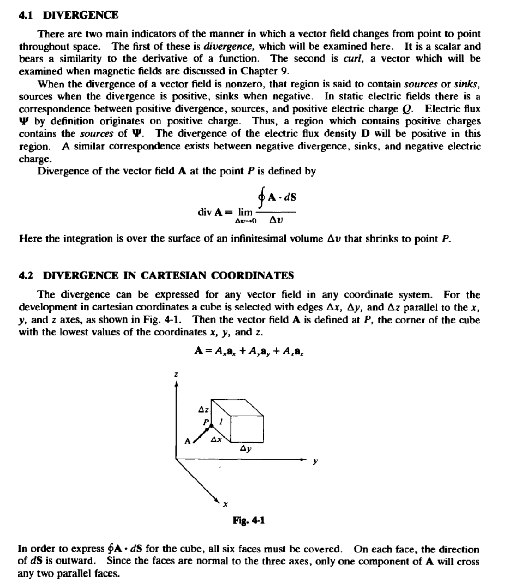
Lecture four/ Divergence and the Divergence theorem

Slide 2

In Fig. 4-2 the cube is turned such that face 1 is in full view ; the x components of A over the
faces to the left and right of 1are indicated. Since the faces are small,
1
A • dS = -Ax(x ) liy liz
_{1"""face} A•dS =Ax(x+ )t:J.yi:J.z
lett face
-[A..(x)+ ^{aA..}
ax lu
]liy liz
A..(x)
A..(x + x)
dS
tu
dS
so that the total for these two faces is
aA.. lu liy liz
ax
The same procedure. is applied to the remaining two pairs of face.co and the results combined.
_{f} A·dS - (^{aA..}+ ^{aA,.} + ^{aAz)} luliyliz
ax ay az
Dividing by lu liy liz== liv and letting liv-+0, one obtains
. A 8'A. aA,. aAz
dIV =-+ +-
(cartesian)
OX ay az
The same approach may be used in cylindrical (Problem 4.1) and in spherical coordinates.
. t a 1aA aAZ
az
dtvA =-_{'ar} (rA )+- _{aq,}
(cylindrical)
1 a _ ₂
r ,
.
1 a .
1 aA.
dtv A=₂-a (rA,) + -:-a (As sm 8) +-.--
(spherical)
r r r sm 8 8
r sm 8 aq,
EXAMPLE 1. Given the vector field A = 5x² sin )•.. find divA at x •1.
(
divA= ^{a (}5x² s.m^{m}-⁾ =5x²⁽co^{m}s-^{):r}-^{c}+lOx s.an^{m}-=⁵-m² cos^{m}-+10xs.m^{m}-
ax
2 22 22 2 2
and div Al...₁=- 10.
EXAMPLE 2. In cylindrical coordinates a vector field is given by A =r sin 4nt,. + ,Z cos 4'•• +2re -s·a..
Find
divA at(!. :rc/2,0).
divA =! (rsin 4') +! (rcos 4') + (2re- ) =-2sin 4' -r sin 4' -lOre-
rar
r 84>
(Jz
and

Slide 3
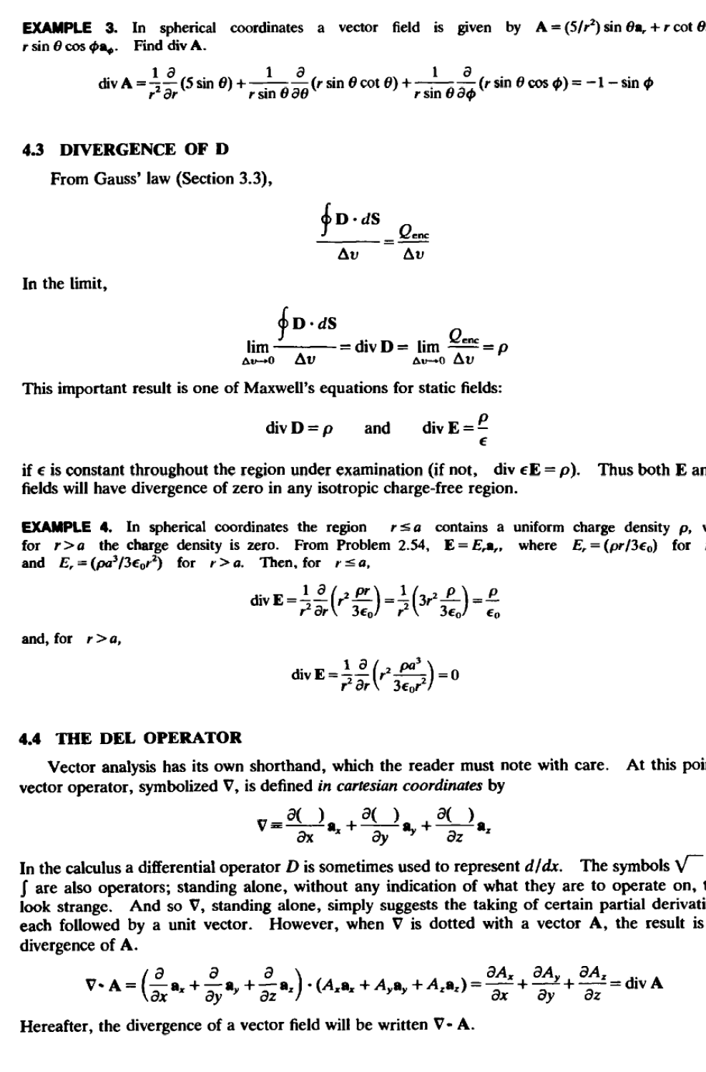

Slide 4
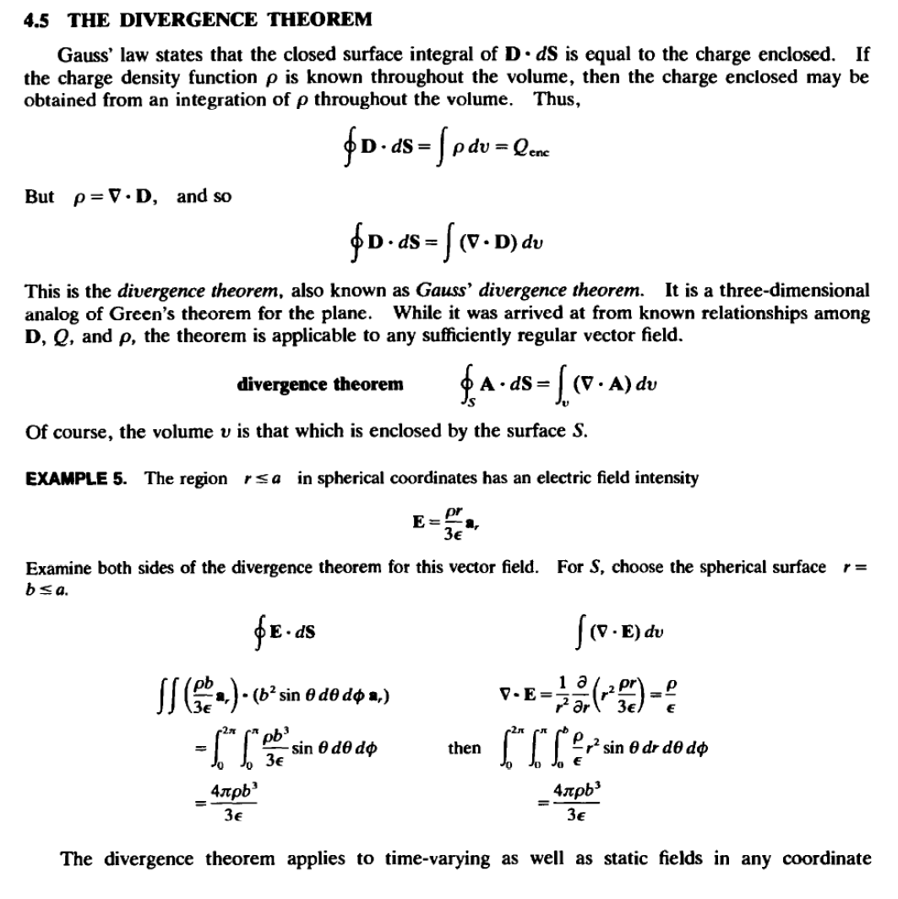

Slide 5
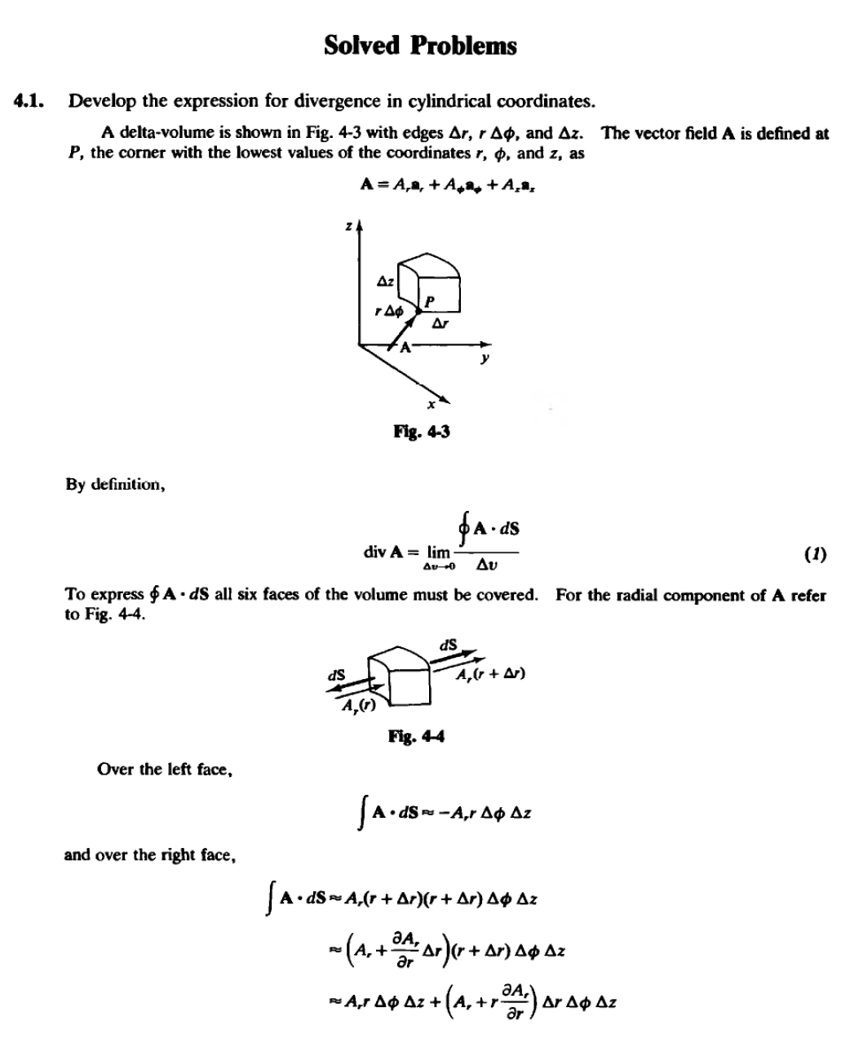

Slide 6
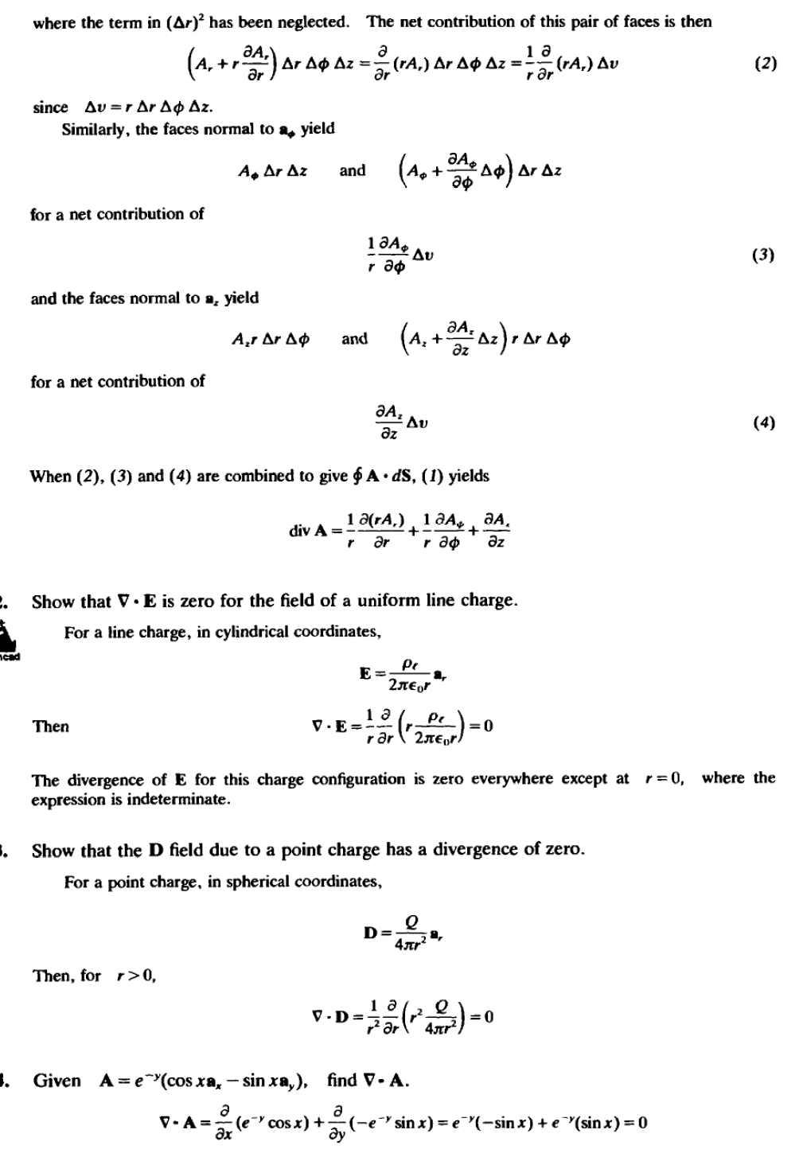

Slide 7

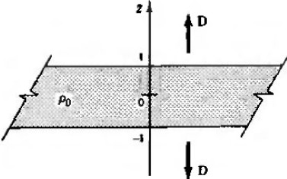
4.5.
Given
A = x²a.. +yza,. +xyaz , find V • A.
a a a
V •A •_{ax} (x + (yz)+ _{az} (xy)=2x +z
CJy
4.6. Given
A= (x²
_{+y -}112
a_.. find V • A at (2. 2,0).
V •A =-!(r +y -³¹²(2x)
and V •Al 2,2.o>-= -8.84 x 10-²
A= r sin ,Pa, +2r cos 4>•• +2z²az,
1
4.7.
Given
find V • A.
ta .
ta
a
V •A = _{rar} ( sm cp) + _{rat} (2r cos cp) +-(2z²
= 2sin t$1 -2 sin cp + 4.z = 4z
az
)
V· A =
10sin² cp + 2z cos² cp
r
a
4.9.
Given
A = (5/r'-)a, + (10/sin 8)a₈ -r²,P sin 8••· find V • A .
ta
1 a 1 a .
V•A =--(5)+---(10)+---(- cpsan 9)= -r
r² ar r sin 9 a8 r sin 8acp
4.10.
Given
A= 5 sin 8ae +5 sin 4'• · find V • A at (0.5, rr/4, rr/4).
1 1
9
V·A =--(5sin² 9)+--(5 sin cp)= 10cos + 5 cos cp
rsin 9a9
rsin 9a.p
V • Al₁o.s...,_{4.,..,4}> = 24.14
r r sin 9
and
4.11.
Given
that D = p₀zaz
in the region -1s z s 1 in cartesian coordinates
and D =
(p₀z/lzl)az elsewhere, find the charge density.
V·D = p
For -t szst,
and for z < -1 or z > I,
a
P = _{az} (=fPo)=O
1be charge distribution is shown in fig. 4-5.

Slide 8

4.U.
Given that D = {10r³/4)a, (C/m²
) in the region 0< r 3m in cylindrical coordinates
and D =(810/4r)a. (C/m²) elsewhere, find the charge density.
For O < r 3m,
p ,.._¹_ª (to,.•) = 10r² (C/m³)
rar 4
and for r >3 m,
p = _{,.a,.}(810/4) =0
1 a
4.13.
Given that
D= ^{Q} (1-cos 3r)a,
-
rrr²
in spherical coordinates, find the charge density.
1 a[- Q
-] 3Q
2
p =_{,.z} - r -(l-cos3r) =-sin 3r
ar trr² trr²
4.14.
In the region 0 <r s 1m, D = (-2 x 10-⁴/r)a, (C/m²
) and for r > l m, D =(-4 x
10-⁴/r)a, (C/m² ,
) in spherical coordinates. Find the charge density in both regions.
For O <r lm,
and for r > lm,
p ^{1 a} (-4 X 10"⁴ =0
⁼rar
)
4.15. In the region r
2, D = (5r/4)a, and
for r > 2, D = (20/r²)a, in
spherical
coordinates. Find the charge density.
For r 2,
1 a
p= (5r⁴/4) = 5r
⁻,za,.
and for r >2,
1 a
P"_{,.a}-,.(20) =0
4.16. Given that D (10x³/3)a (C/m² ,
) evaluate both sides of the divergence theorem for the
1
volume of a cube, 2m on an edge, centered at the origin and with edges parallel to the axes.
fn·dS = L(V·D)dv
Since D has only an x component, D • dS is zero on all but the faces at x = 1m and x = -1m (see
Fig. 4-6).
_{f} D ·dS== _{I}^{I It 10(1)}•..·dyd:ta.+ ^{J' It 10( 1)}•.·dydz(-a.)
-1 -1 3 -1 - t 3
40 40 80
=-+-=-C
3 3 3

